Slide 1

TUGA IT 2017
LISBON, PORTUGAL
A brave new world
Mac OS X, PowerShell and Linux
@Jaap_Brasser

Slide 2





THANK YOU TO OUR SPONSORS

Slide 3









PARTICIPATING COMMUNITIES
CLOUD
PRO
PT

Slide 4
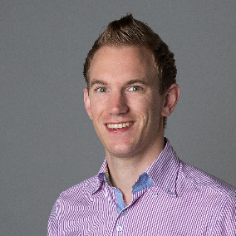
PowerShell Fanatic
GitHub
PowerShell Gallery
TechNet Gallery
@Jaap_Brasser
whoami.exe /priv
Jaapbrasser.com/about

Slide 5
Agenda
What is new in PowerShell 6
The open source mission
Technical demos
Summary and Questions

Slide 6

What is new with PowerShell

Slide 7
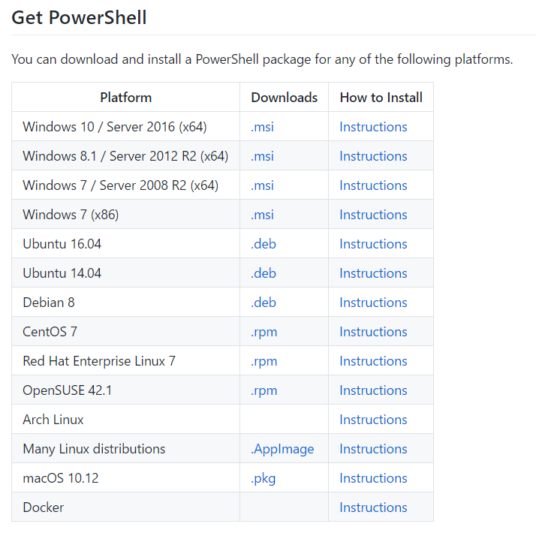
PowerShell 6 Beta 1
.Net Core 2
11 alpha releases
Aliases removed
PowerShell Remoting
PoSh SSH Remoting

Slide 8

Agenda
Differences between editors
Configure VSCode
Working with Vscode
Setting up the ISE
Working with the ISE and ISESteroids
Questions
Demo

Slide 9
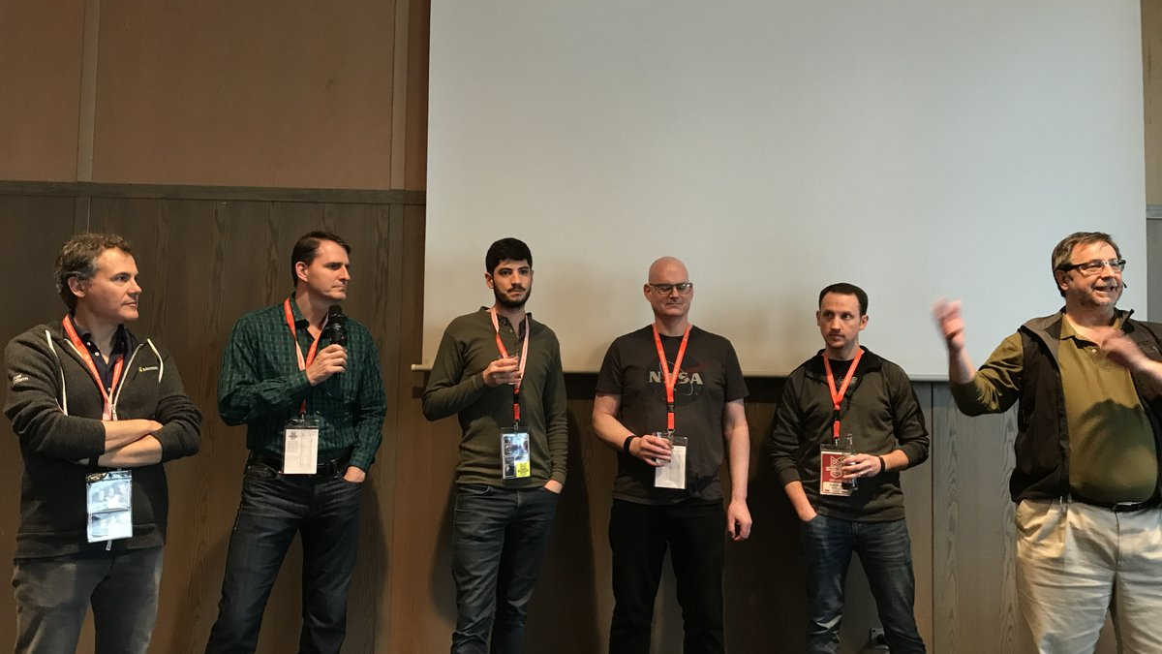
PowerShell Open Source

Slide 10

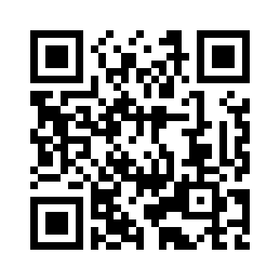
PLEASE FILL IN EVALUATION FORMS
FRIDAY, MAY 19th
SATURDAY, MAY 20th
https://survs.com/survey/cprwce7pi8
https://survs.com/survey/l9kksmlzd8
YOUR OPINION IS IMPORTANT!

Slide 11
THANK YOU TO OUR SPONSORS

